Slide 1
Gauteng Apartment Rental Market: A Feature-Based Price Variation Analysis
Aron Moganedi

Slide 2
Key Questions
Does location and estate agent influence apartment rental prices across Gauteng?
And to what extent do internal apartment features, number of bedrooms, bathrooms, parking spaces and floor size, collectively and individually account for monthly rental price variation?

Slide 3
Database market analysis p1
Combined, all six observed attributes in this dataset account for about 59.8% of monthly price variation across apartment listings. Unobserved features, such as amenities, apartment furnishings, and extras, could account for the remaining 40.2%.
There is a very inconsistent relationship (0.23) between bedrooms and monthly price. This indicates that bedrooms only account for about 5.29% of price variation between listings. When price responds to bedrooms, it usually drives up by R3 481.47
There is a moderately consistent relationship (0.48) between bathrooms and monthly price. This indicates that bathrooms account for about 23% of price variation between listings. When price does respond to bathrooms, it usually drives up by R8 211.95 in this dataset.

Slide 4
Database market analysis p2
There is very low correlation (0.22) between parking spaces and monthly prices, which indicates that the number of parking spaces only accounts for around 4.84% of price variation between listings. Each additional parking space drives prices up by R408.71.
There is a fragile correlation (0.13) between the floor size and monthly prices, which indicates that the floor size only accounts for around 1.69% of price variation between listings. When price does respond to floor size, it usually drives up by R53.52.
After running the Kruskal-Wallis Test on the cities in the database, we can conclude that location influences price variation across apartment listings. Furthermore, Sandton tends to have higher-priced apartments than the other three cities (Midrand, Pretoria and Johannesburg). The points are similar for estate agents.

Slide 5
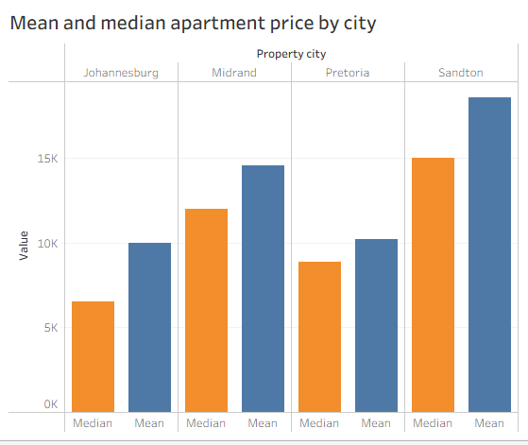
On average, Sandton has the most expensive apartments between all four cities.

Slide 6
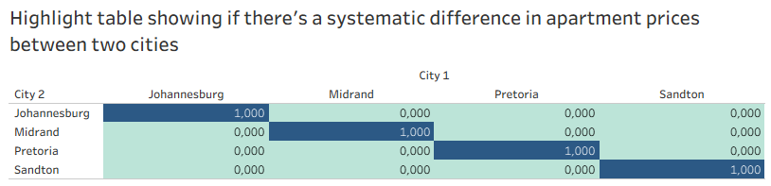
The cells in light blue indicate that there’s systematic differences in prices between the cities. This substantiates our claim that location influences monthly price differences across apartments.

Slide 7
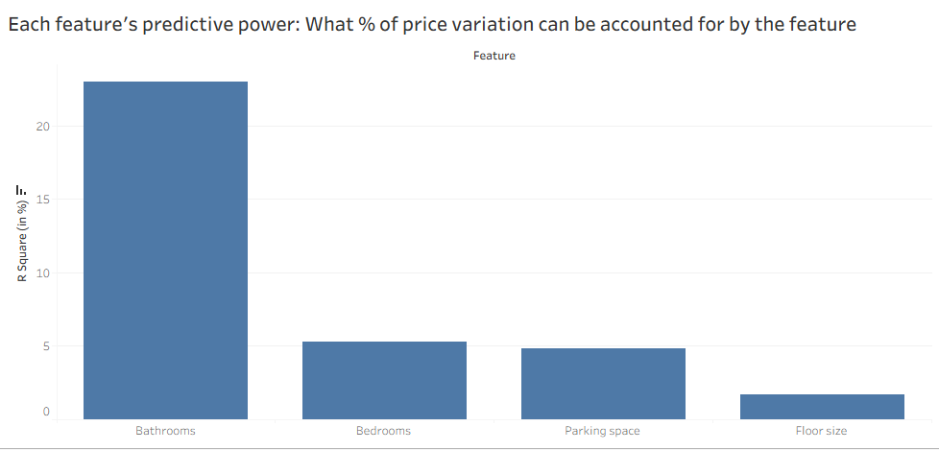
The R-squared of a variable measure how much that variable can account for the price difference across apartments. It is derived from the correlation between each variable and apartment price, meaning that the higher the R-squared the stronger the relationship between the two variables.

Slide 8
Final Thoughts
Monthly prices always consider intrinsic properties such as bedrooms, bathrooms, and floor size, so it was fascinating to learn how much they influence the price variation and in what ways they do. Furthermore, we were able to substantiate our claim that price is dependent on location, indicating that cities such as Sandton tend to have higher-priced apartments than cities such as Pretoria.

Slide 9
Thank you
Aron Moganedi
+27 63 374 4529 | moganedilifa@gmail.com
https://amoganedi.github.io/PortfolioWebsite/

